Slide 1
Factors Affecting Basketball Players Salary

Slide 2

Team 7
NOTE:
To change images on this slide, select a picture and delete it. Then click the Insert Picture icon
in the placeholder to insert your own image.
Anthony Nguyen
Helen Au
Shadi Salama
Warren Vince Sy

Slide 3
Content
Core hypothesis and main questions
Data source
Data cleaning
Analysis process
Conclusions
Findings
Q&A

Slide 4
Core hypothesis and main questions
Question 1
Is the player position affect the player salary?
Question 2
What are the top factors that affects the players salary?
Question 3

Slide 5


Data source
ESPN.com
NBA.com

Slide 6




Teams Analysis
The study includes four team in California
Golden state warriors
LA Clippers
Sacramento Kings
Lakers

Slide 7
Data Cleaning
Players Stats Dataset
Cleaning process:
Aa a aa a a
Bb b bbbb bbb
Cc CCcccc ccc
Players Salaries and Positions Dataset
Cleaning process:
Aa a aa a a
Bb b bbbb bbb
Cc CCcccc ccc

Slide 8
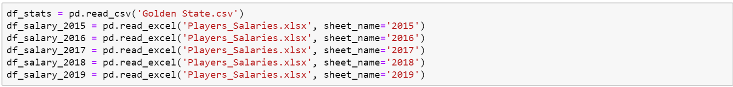
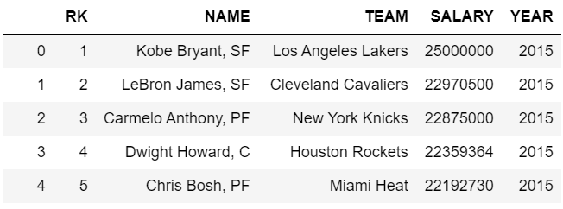
Converting Excel File w/ multiple sheets into a single data frame

Slide 9
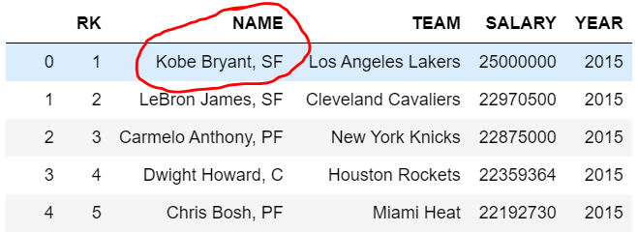
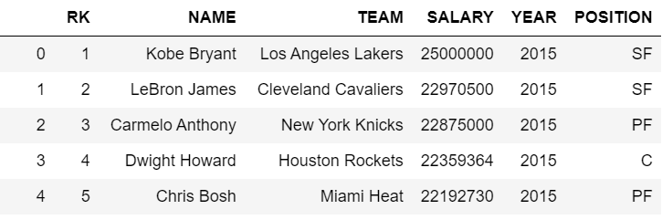
Splitting one column(Name) into two different columns (Name) and (Position)

Slide 10
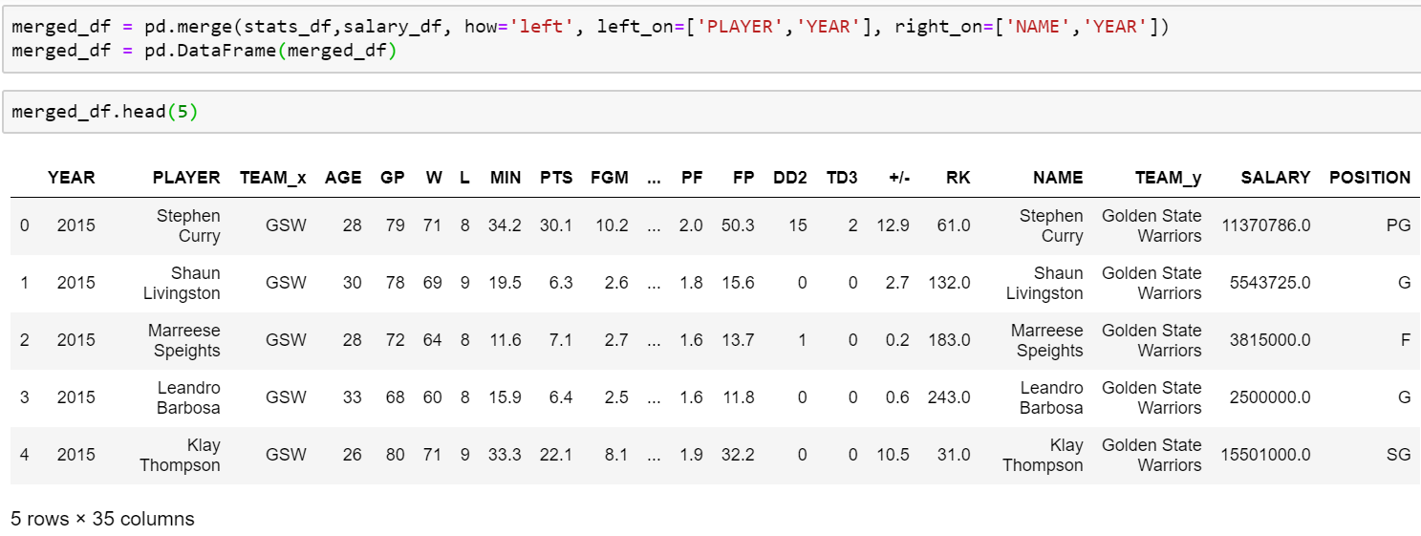
Merge Data Frames using 2 key values

Slide 11
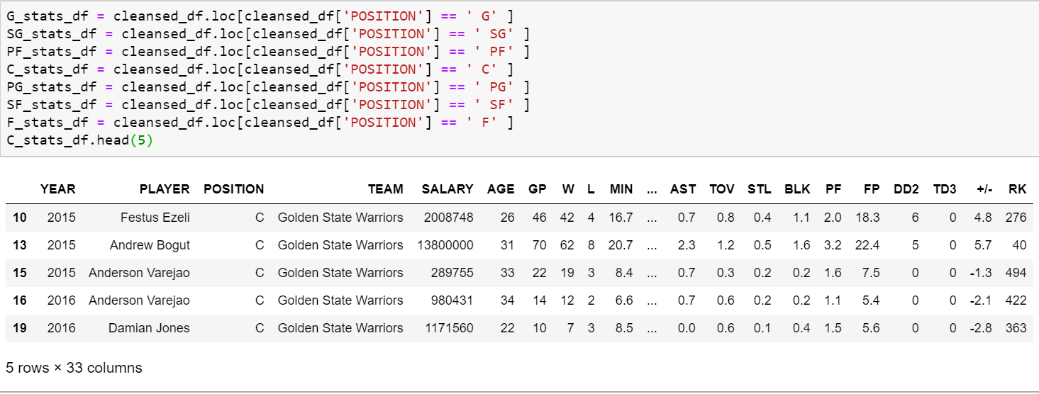
Creating Multiple Dataframes based on Position

Slide 12
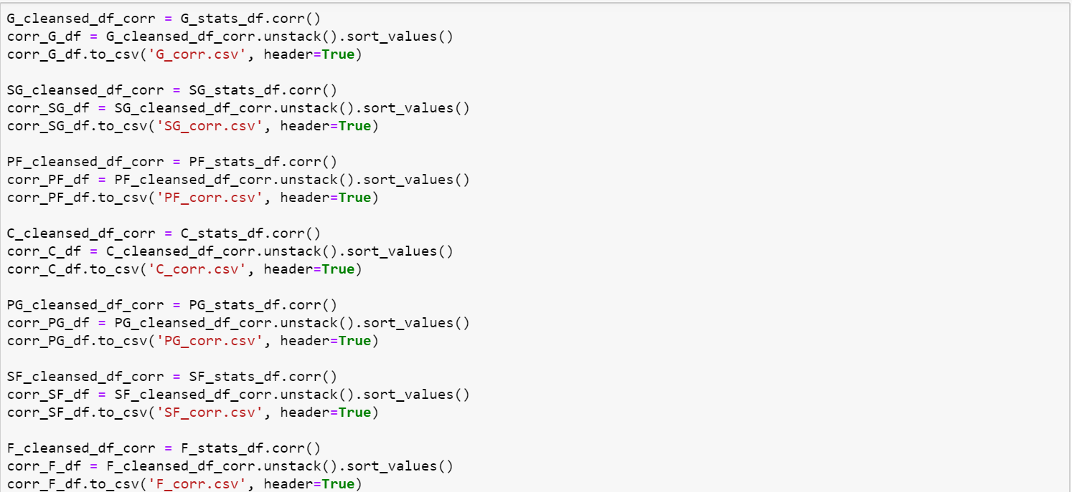
Check Correlation of all stats against salary per position

Slide 13
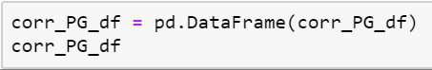
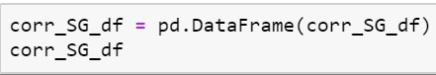
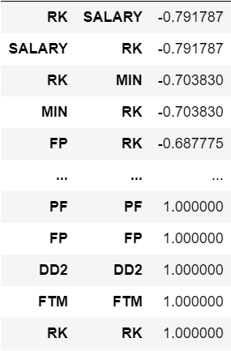
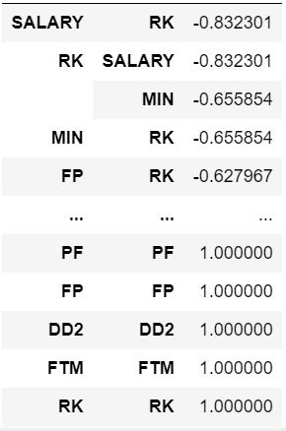
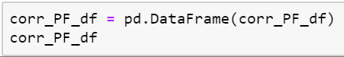
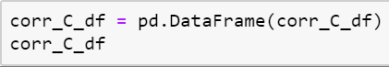
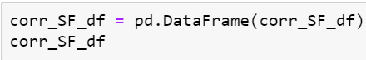
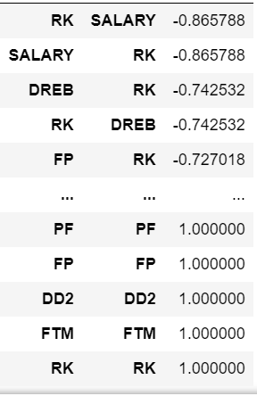
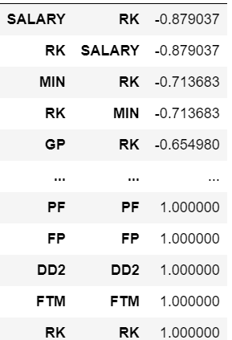
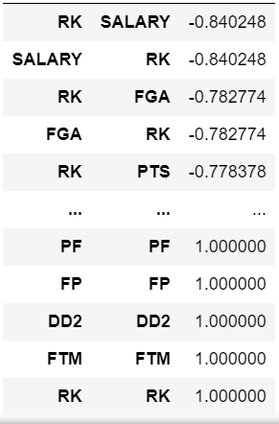
Correlation Results by Position

Slide 14
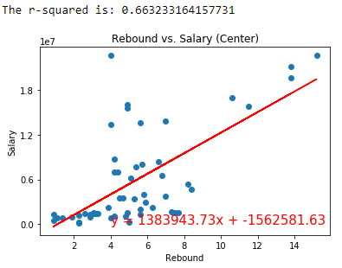

Center Position
Statistic awarded to a player who retrieves the ball after a missed field goal or free throw
Height is so important, most rebounds are made by centers

Slide 15
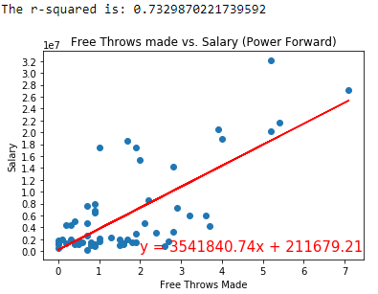
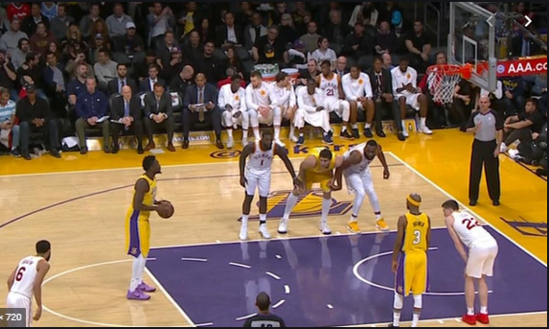
Power Forward
Free Throws are generally awarded after a foul on the shooter.
Most fouls happen inside the box.

Slide 16
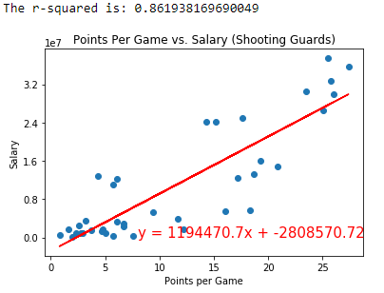

Shooting Guard
Ultimate objective of basketball is to score.
Shooting guards are known for their prolific scoring abilities.

Slide 17
Correlation Analysis process
Finding correlation for all stats vs salary for all players in four teams:
We used the correlation function (df_corr.unstack().sort_values()) in Jupyter Notebook.
Display the Data Frame in Jupyter Notebook.
Export the Data Frame to CSV
Create conditional format rule in excel to visualize the correlation between salaries for all 324 players and each stats.
Visualize the details using excel chart
-0.3 < value < 0.3 - None or very weak correlation

Slide 18
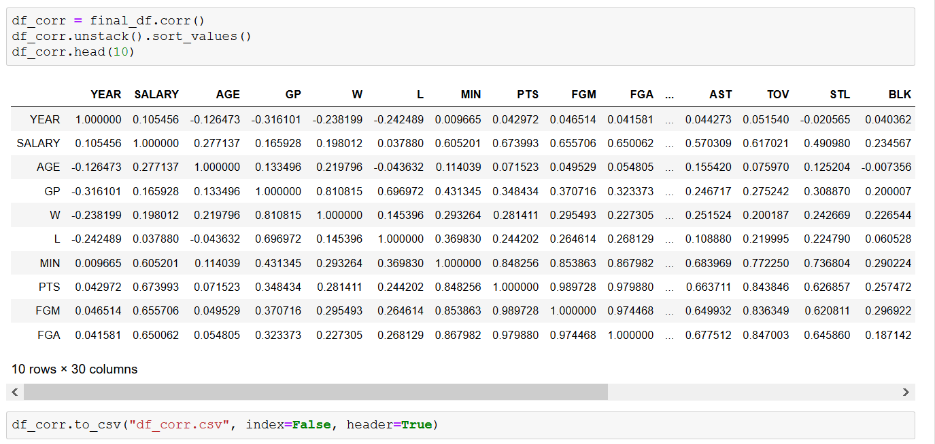
Analysis process
Finding correlation for all stats vs salary for all players in four teams:
We used the correlation function (df_corr.unstack().sort_values()) in Jupyter Notebook.
Display the Data Frame in Jupyter Notebook.
Export the Data Frame to CSV

Slide 19
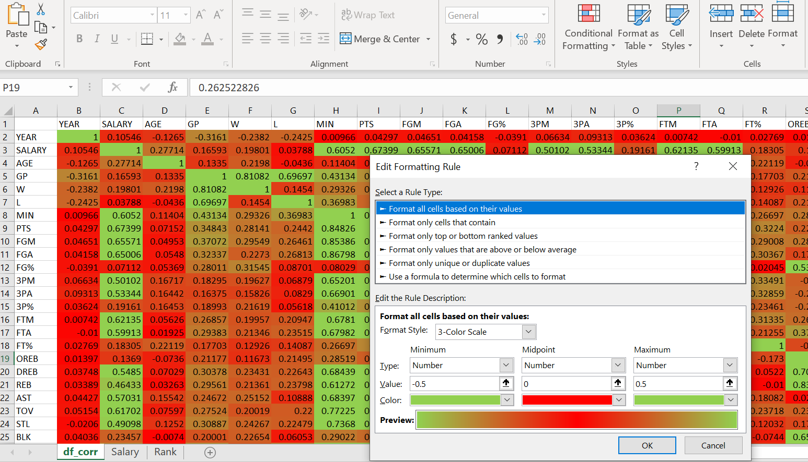
Correlation Analysis process
Finding correlation for all stats vs salary for all players in four teams:
Create conditional format rule in excel to visualize the correlation between salaries for all 324 players and each stats.
Visualize the details using excel chart
-0.3 < value < 0.3 - None or very weak correlation

Slide 20
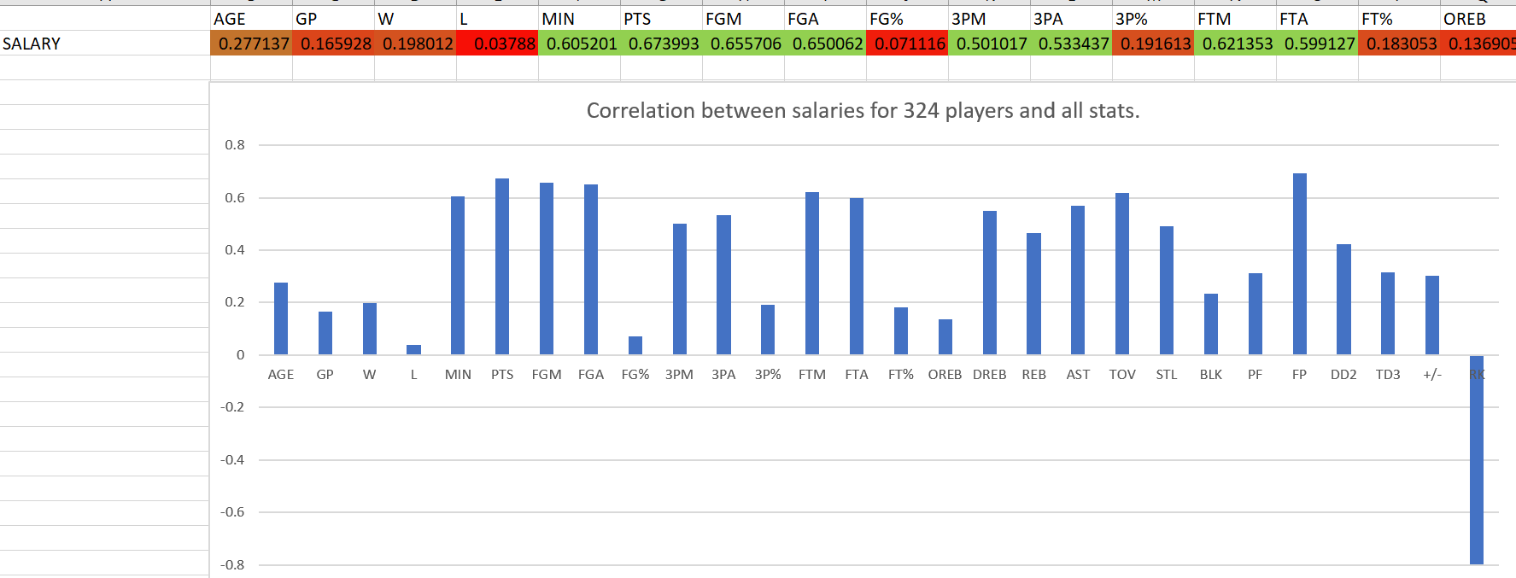
Correlation Analysis process
Finding correlation for all stats vs salary for all players in four teams:
Visualize the details using excel chart
-0.3 < value < 0.3 - None or very weak correlation

Slide 21
Top five stats affecting salary
Points vs Salary (r - value is 0.673993)
Field goals vs Salary (r - value is 0.655705)
Field goals attempted vs Salary (r - value is 0.650062)
Minutes Played vs Salary (r - value is 0.605200)
3 Point Field Goals Made vs Salary (r - value is 0.501017)

Slide 22
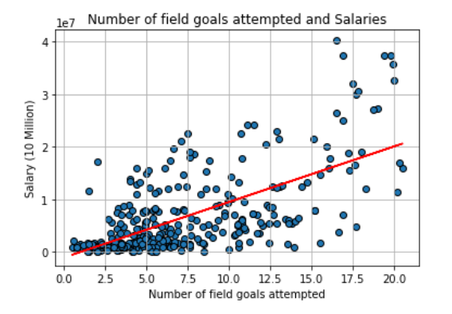
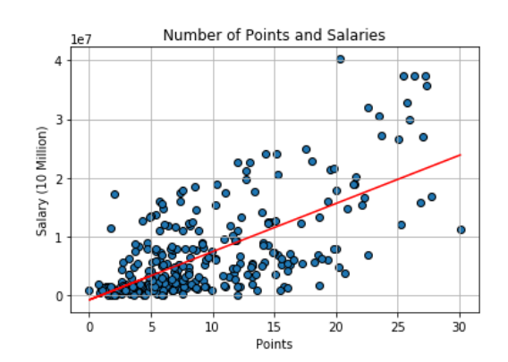
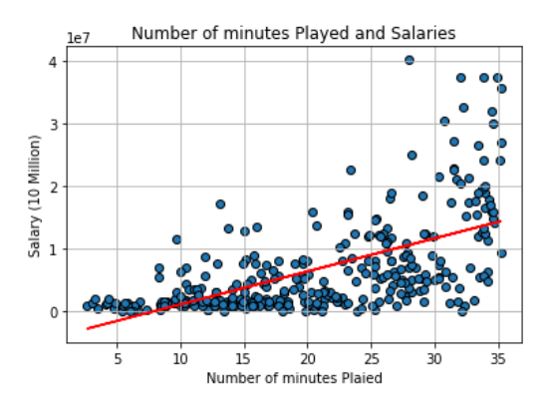
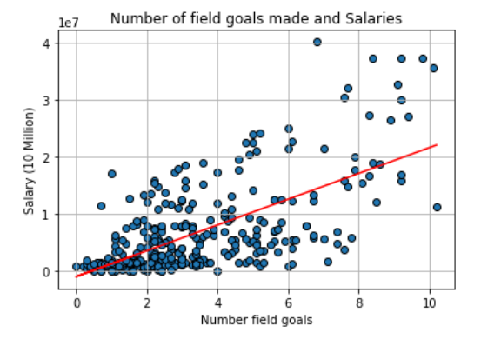
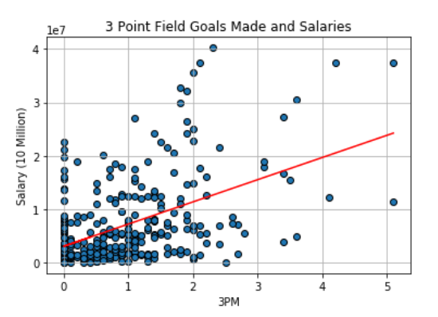
Top five stats affecting salary
Points vs Salary (r - value is 0.673993)
Field goals vs Salary (r - value is 0.655705)
Field goals attempted vs Salary (r - value is 0.650062)
Minutes Played vs Salary (r - value is 0.605200)
3 Point Field Goals Made vs Salary (r - value is 0.501017)

Slide 23
Conclusion and Finding
Finding 1
Finding 2
Finding 3

Slide 24
Q & A

Slide 25
Thank you

Slide 26
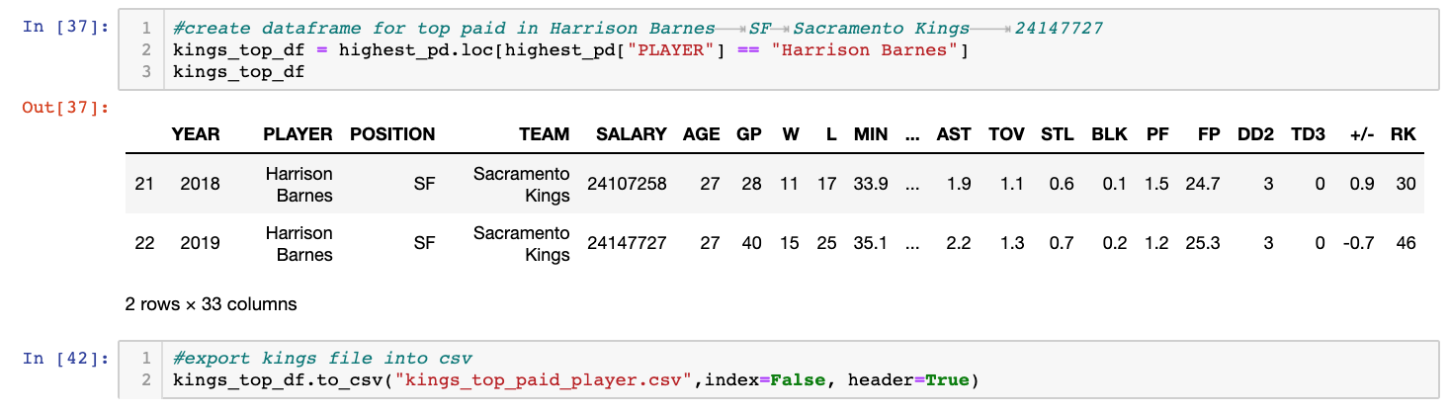
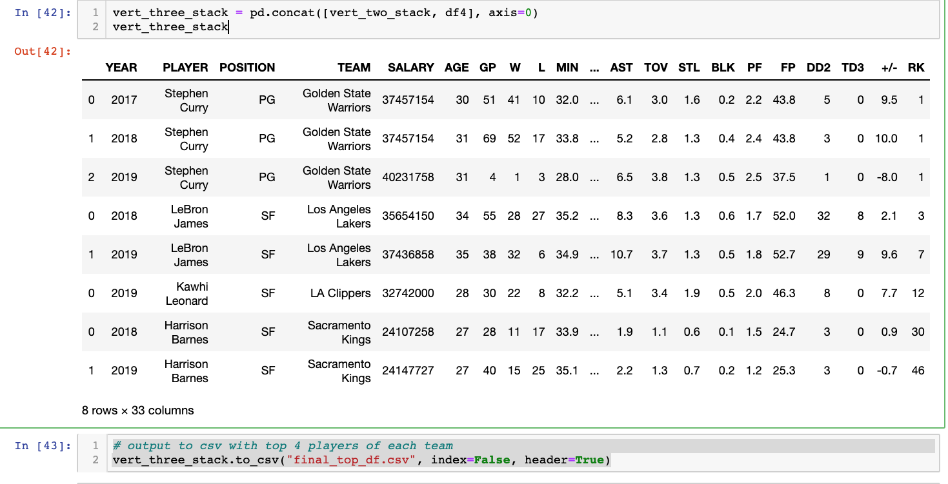
Created CSVs For Top Salaries and Concat To New CSV
Find highest paid correlation:
Step 1: Find highest paid players: Used CSV file to create dataframes and output csv for the highest paid players of each 4 teams.
Step 2: Used new CSV to filter highest paid player for each team.
Step 3: Used Concat feature with 4 CSV files to create one csv file for Top paid players for each team.
Step 4: Plotted Graph for Top Player per California Team

Slide 27
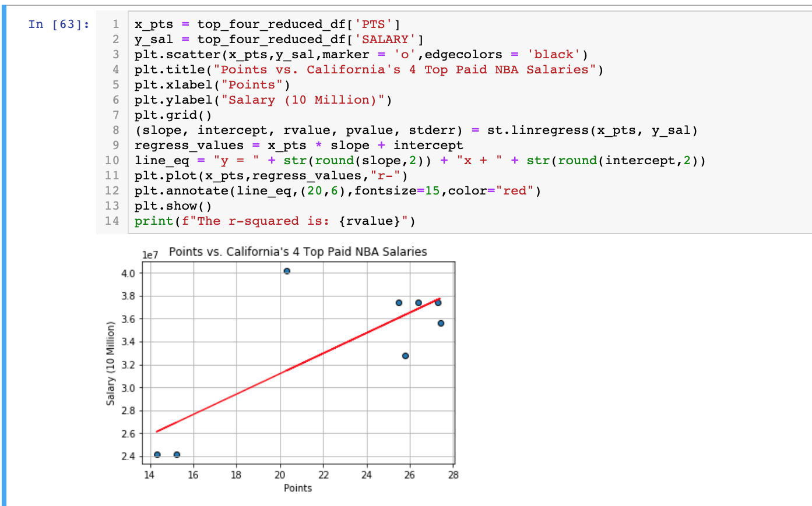
Results
Used the final csv to plot only 4 top paid players of 4 teams

